Slide 1
The Effect of Font on Product Purchasing Behavior
Notes:
Leah

Slide 2
Statement of the Problem
The purpose of this study was to determine whether the type of font used on a product or in an advertisement can influence the purchasing behavior of consumers.
Notes:
Leah

Slide 3
Statement of the Problem: Definitions
Fonts are generally described as either “hard” or “soft” based on their design.
Hard fonts are sans-serif fonts. These fonts are often described as cold, unemotional, strong, or masculine.
Soft fonts are serif fonts. These are often described as warm, delicate, and feminine.
Notes:
Delaney

Slide 4
Research Background: Choi & Kang
Choi & Kang (2013) conducted a study to determine whether hard and soft fonts change the readability and desirability of an advertised product.
Participants rated the likability of each font by rating them on a 7 point Likert scale of positive/negative, favorable/unfavorable etc.
They also tested how congruent the fonts are perceived to be with the advertisement.
Findings showed that across participants, the soft fonts were preferred over the hard fonts.
Notes:
Delaney

Slide 5
Research Background: Fenko & Drost
Fenko & Drost (2014) tested whether women are more likely to prefer stereotypical product designs such as feminine font, color, and shape.
The study used four images total, with two showcasing a product in either an “independent” scenario featuring a businesswoman and two showing an “interdependent” scenario featuring a mother.
In either scene they were presented with a gender neutral product design using a hard font, or a traditionally feminine product design using a soft font.
Results suggested that women would be more likely to prefer the soft font when used on a gender neutral product, but were less likely to choose the same font on a stereotypically feminine product.
Notes:
Delaney

Slide 6
Research Background: Gump
Gump (2010) conducted a study to see if font affects the reader’s emotions and mood. The participants rated 10 varying serif and sans serif fonts on the terms rigid, friendly, plain, and elegant.
The majority of participants chose favorite font as one that was “friendly” or “elegant” as opposed to “masculine” fonts.
The findings showed that there was consensus on which font corresponded with which descriptors. This shows that fonts can elicit particular emotions and perceptions.
Notes:
Leah

Slide 7
Research Background: Tantillo, DiLorenzo-Aiss, & Mathisen
Tantillo, DiLorenzo-Aiss, & Mathisen (1995) wanted to determine if typeface influences affective responses.
They created 28 scales of descriptors, including beauty, elegance, quality, and sturdiness.
Participants rated 3 serif and 3 sans-serif fonts on how much they correlated with the descriptor words, on a scale from 1 to 7.
The findings showed that participants rated soft fonts as being more desirable on nearly all of the descriptors, including elegance.
However, they rated hard fonts as being more powerful and sturdy.
Notes:
Leah

Slide 8
Hypotheses
Hypothesis #1
Hypothesis #2
Hypothesis #3
Hypothesis #4
Notes:
Leah

Slide 9
Hypothesis #1
Rationale:
Hypothesis:
Choi & Kang (2013) looked at the desirability of products using hard vs. soft fonts.
They found that soft fonts were largely prefered over the hard fonts
Both male and female participants will show more interest in purchasing products that use ‘soft’ typeface.
Notes:
Leah

Slide 10
Hypotheses
Hypothesis #1
Hypothesis #2
Hypothesis #3
Hypothesis #4
Notes:
Leah

Slide 11
Hypothesis #2
Rationale:
Hypothesis:
Gump (2010) found in his study that “elegant” fonts were favored over “masculine” fonts.
Tantillo, DiLorenzo-Aiss, & Mathisen (1995) found that soft fonts were described as more elegant and higher quality than hard fonts.
All participants will be more likely to perceive ‘soft’ fonts as elegant or higher quality regardless of product type.
Notes:
Leah

Slide 12
Hypotheses
Hypothesis #1
Hypothesis #2
Hypothesis #3
Hypothesis #4
Notes:
Leah

Slide 13
Hypothesis #3
Rationale:
Hypothesis:
Tantillo, DiLorenzo-Aiss, & Mathisen (1995) found that while soft fonts were rated higher in elegance and quality, hard fonts were rated higher in “sturdiness.”
Participants will be more likely to perceive ‘hard’ fonts as more durable, regardless of gender.
Notes:
Delaney

Slide 14
Hypotheses
Hypothesis #1
Hypothesis #2
Hypothesis #3
Hypothesis #4
Notes:
Leah

Slide 15
Hypothesis #4
Rationale:
Hypothesis:
Fenko & Drost (2014) found that when presented with both a gender neutral product using a hard font and a stereotypically feminine product using a soft font, women were more likely to choose the soft font on a gender neutral product than on a product aimed directly at women.
Women will be more likely to prefer the soft font on a gender-neutral product than on a gender specific product
Notes:
Delaney

Slide 16
Methods: Participants
Number of subjects = 66
Males = 17
Females = 49
Mean Age = 38.5
Notes:
Leah

Slide 17
Method: Design
Mixed Experimental Design
Within subjects
2 independent variables with 2 conditions each
Product type: gender specific & gender neutral
Font type: soft & hard
Dependent
Variables
Purchasing Likelihood
Perception of Elegance
Perception of Durability
Changing font type: 2 types - Hard (LEMON/MILK)vs Soft (Lucida Handwriting)
Gender neutral (black bottle and cell phone) vs. Gender specific (colored bottle)
Independent
Variables
Notes:
Leah

Slide 18
Method: Materials
For this study we chose one Serif font and one Sans-Serif font.
Serif: Lucida Handwriting
Sans-Serif: LEMON/MILK
Notes:
Delaney

Slide 19
Method: Survey Materials
Which gender do you most closely identify with?
Please select your age.
How likely are you to purchase body wash?
Demographic Questions:
Which product would you be most likely to purchase?
Which product would someone else be most likely to purchase?
Which product seems more elegant?
Which product seems to be of higher quality?
Which product seems like it would last longer?
Questions about body wash:
Questions about cell phone add:
Which product would you be most likely to purchase?
Which product seems more expensive?
Which product seems more durable?
Which product seems more technologically advanced?
Notes:
Delaney

Slide 20
Methods: Procedure
Participants were directed to a survey where they were first asked basic demographic information, including their age, gender and likelihood to purchase a body wash product.
All participants then viewed two nearly identical grey bottles of body wash with different fonts and answered randomized questions regarding their opinions on the product.
Then they did the same with another set of nearly identical bottles, this time shown in colors traditionally stereotyped as feminine or masculine. Again, the only difference between the two was the use of a hard or soft font.
Males were shown blue bottles and females were shown pink bottles.
Finally, participants were shown a set of cell phone advertisements and asked randomized questions regarding their opinions on the product.
Notes:
Delaney

Slide 21
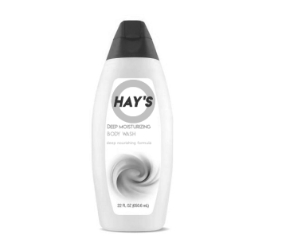
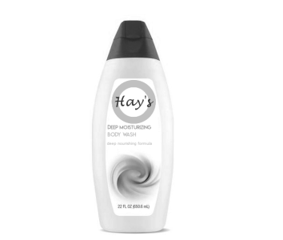
Gender Neutral Product Targeted Towards All Participants
Notes:
Delaney

Slide 22
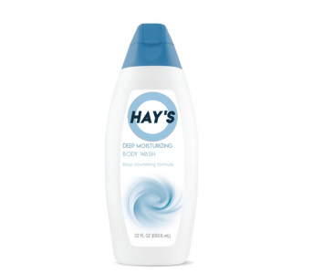
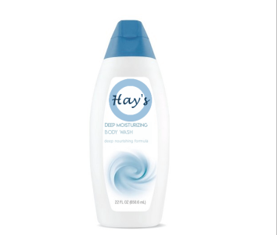
Gender Specific Product Targeted Towards Male Participants
Notes:
Delaney

Slide 23
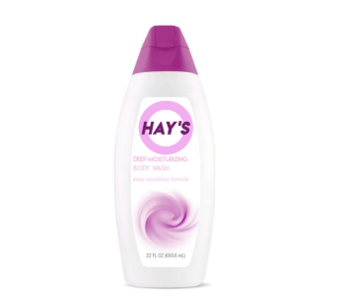
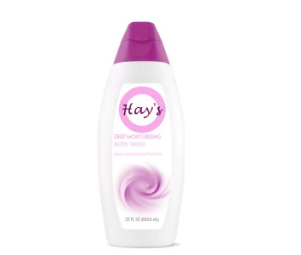
Gender Specific Product Targeted Towards Female Participants
Notes:
Delaney

Slide 24
Gender Neutral Product Targeted Towards All Participants
Notes:
Delaney

Slide 25
Data Source
Chi Square tests to compare observed vs expected values
Gender x font crosstabulation
- Likelihood to purchase
-Elegance
-Durability
Product type x font crosstabulation
Notes:
Leah

Slide 26
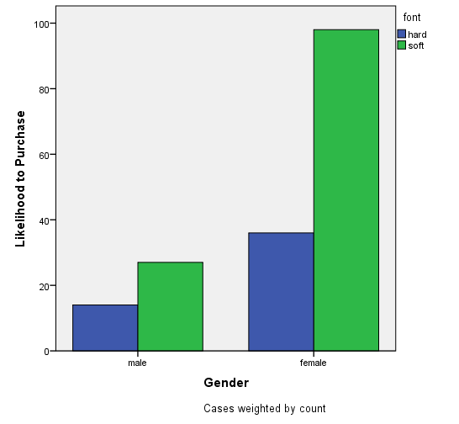
Results of Hypothesis #1
Hypothesis #1:
Both male and female participants will show more interest in purchasing products that use “soft” font.
Hard Soft
Males: 14 27
Females: 36 98
These result show a trend in support of the hypothesis, but are not statistically significant.
χ²(2, N=175)=1.03, N.S.
Notes:
Leah

Slide 27
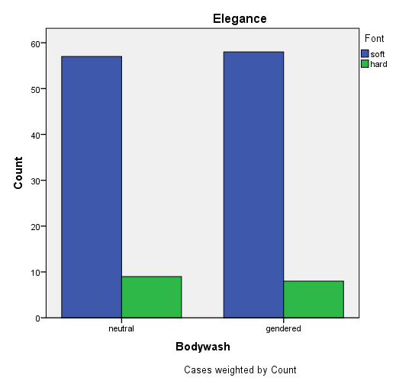
Results of Hypothesis #2
Hypothesis #2:
All participants will be more likely to perceive ‘soft’ fonts as elegant or higher quality regardless of product type.
Means: Hard Soft
Gendered: 8 58
Neutral: 9 57
The data supports the hypothesis, but is not statistically significant.
χ² (1, N=132)= .068, N.S.
Notes:
Leah

Slide 28
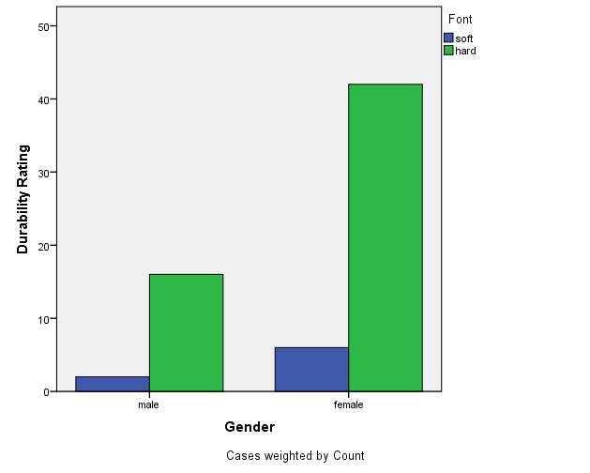
Results of Hypothesis #3
Hypothesis #3:
Participants will be more likely to perceive ‘hard’ fonts as more durable, regardless of gender.
Means: Hard Soft
Males: 16 2
Females: 42 6
The data shows trends in support of the hypothesis but is not statistically significant χ²(1, N=66)= .024, N.S.
Notes:
Delaney

Slide 29
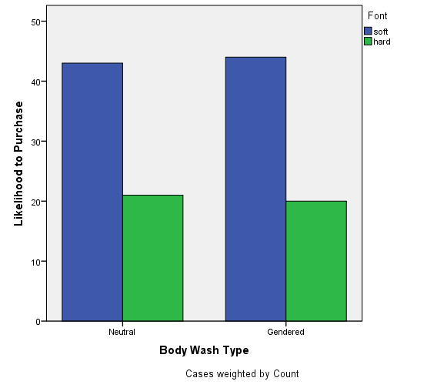
Results of Hypothesis #4
Hypothesis #4:
Women will be more likely to prefer the soft font on a gender-neutral product than on a gender specific product.
Hard Soft
Gendered (Pink): 20 44
Neutral: 21 43
The results here do not support the hypothesis, as the results were nearly the same in both conditions.
χ²(1, N=128)= .036, N.S.
Notes:
Delaney

Slide 30
Interpretation of Results
Our data showed soft trends in support of Hypothesis #1, Hypothesis #2, and Hypothesis #3.
Results of hypothesis #1 suggest that people are more likely to prefer a “softer” font over a “hard” one.
Hypothesis #2 shows that a “soft” font is overall more likely to be perceived as “elegant” than a “hard” font.
Hypothesis #3 suggest that regardless of gender, people perceive a “hard” font as more “durable” than a “soft” font.
However, the data in all three of these results was not statistically significant and therefore can not be used to generalize to the general population.
Hypothesis #4 was not supported by our data, and results suggest that women display a trend of preferring a soft font regardless of neutral or stereotypical product design.
Notes:
Delaney

Slide 31
Discussion
There was a limited number of males taking survey, and their results cannot be generalized to the general population.
The sample size was smaller than we had hoped for, and the results cannot be generalized to the general population.
Participants may just dislike one or both of the fonts chosen, and that will affect their selections.
Limited time kept the survey short, so there were only a few questions about each product. More questions might have given a more complete picture.
Limitations
Notes:
Delaney

Slide 32
Discussion cont.
A larger study using a variety of products could potentially decrease the possibility of general disinterest in one type of product.
Use of a larger variety of fonts could decrease dislike for one particular font style.
Future studies could ask questions to determine how consumers perceive the value of a product based on the font used.
Recommendations for further studies
Notes:
Delaney

Slide 33
References
Choi, S. M., & Kang, M. (2013). The Effects of Typeface on Advertising and Brand Evaluations : The Role of Semantic Congruence. The Journal of Advertising and Promotion Research,2(2). Retrieved March 15, 2018.
Fenko A., Drost W. (2014). A study in pink: what determines the success of gender-specific advertising. 13th International Conferences on Research in Advertising (ICORIA), Amsterdam.
Gump, John E. “The Readability of Typefaces and the Subsequent Mood or Emotion Created in the Reader.” Journal of Education for Business, vol. 76, no. 5, 2001, pp. 270–273.,doi:10.1080/08832320109599647.
Tantillo, J., DiLorenzo-Aiss, J., & Mathisen, R. E. (1995). Quantifying perceived differences in type styles: An exploratory study. Psychology & Marketing, 12(5), 447–57

